Slide 1
BIOE 498 / BIOE 599: Computational Systems Biology for Medical Applications CSE 599V: Advancing Biomedical Models Lecture 6: Model Solutions & System Response
Joseph L. Hellerstein*
Herbert Sauro**
*eScience Institute, Computer Science & Engineering
**BioEngineering

Slide 2
Model Solvers
Motivating example – lac operon
Alternative methods
Software
In class exercise

Slide 3
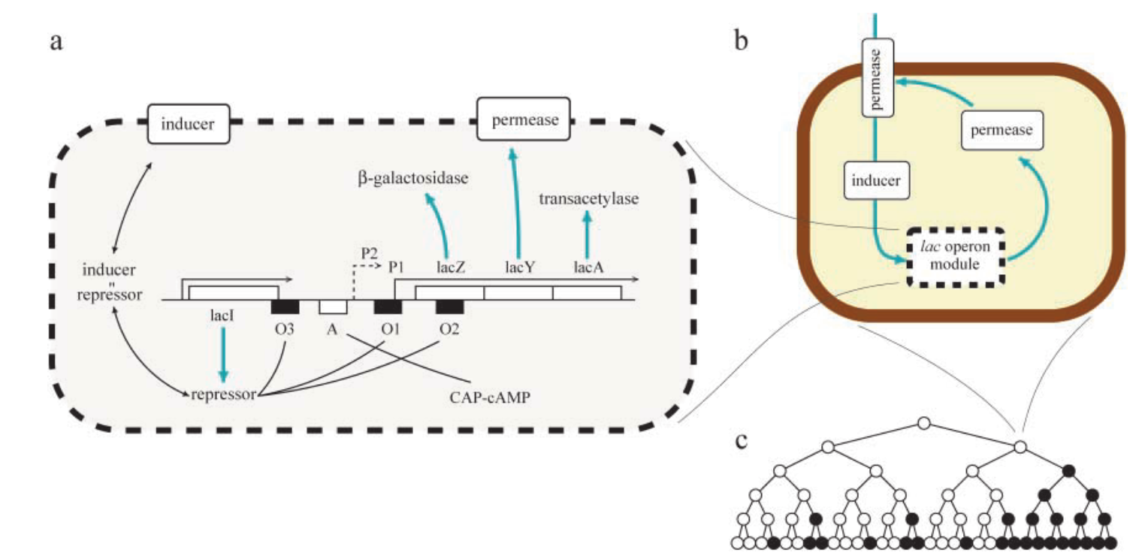
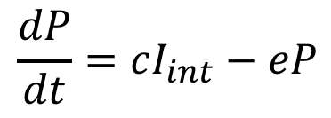
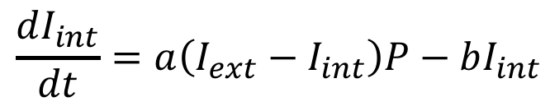


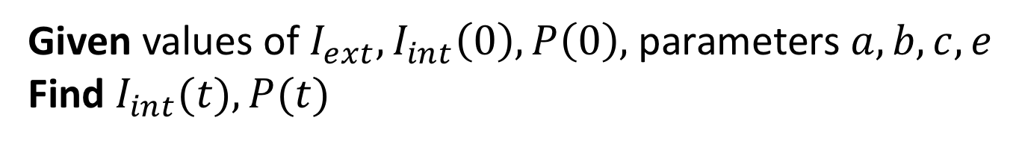

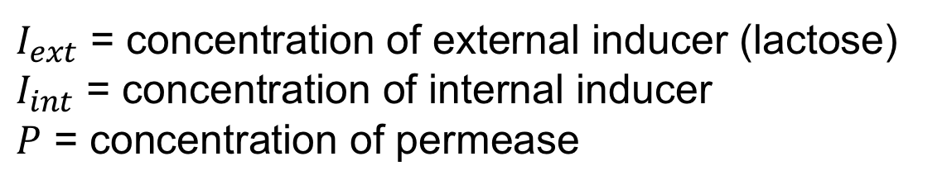
Motivation: Model of the lac Operon
System Diagram
$I_{ext}$
$$\frac{dI_{int}}{dt}=a\left(I_{ext}−I_{int}\right)P−bI_{int}$$
$$P$$
$$I_{int}$$
$$\frac{dP}{dt}=cI_{int}−eP$$
$I_{ext}$ = concentration of external inducer (lactose)
$I_{int}$ = concentration of internal inducer
$P$ = concentration of permease
*Vilar et al., 2003. Journal of Cell Biology.
Given values of $I_{ext},I_{int}\left(0\right), P\left(0\right),$parameters $a,b,c,e$
Find $I_{int}(t),P(t)$
Notes:
State vs. input variables for time?

Slide 4
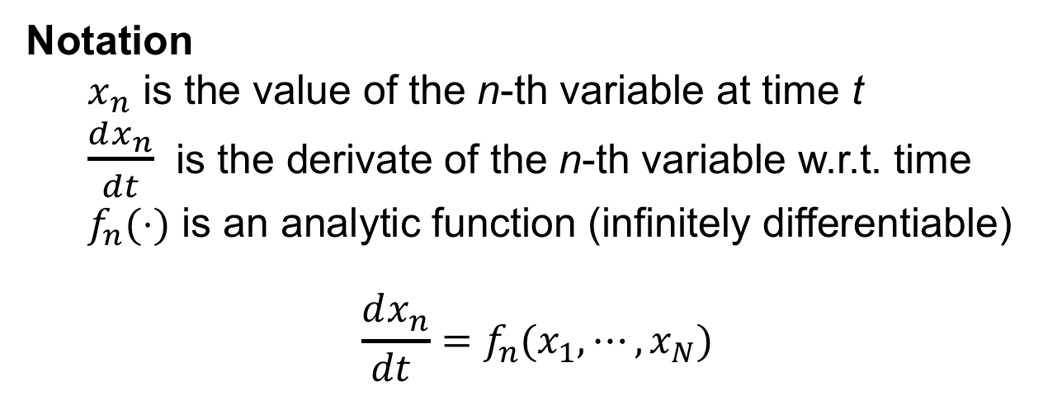
Initial Value Problem (IVP)
Given
N ordinary differential equations in N variables
Values for the N variables at time 0
Find
Values of the N variables over time
Notation
$x_{n}$ is the value of the n-th variable at time t
$\frac{dx_{n}}{dt}$ is the derivate of the n-th variable w.r.t. time
$f_{n}(⋅)$ is an analytic function (infinitely differentiable)
$$\frac{dx_{n}}{dt }=f_{n}(x_{1},⋯,x_{N})$$
Notes:
State vs. input variables for time?

Slide 5
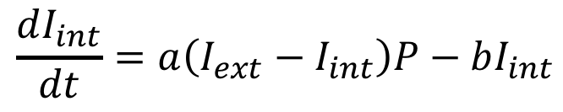
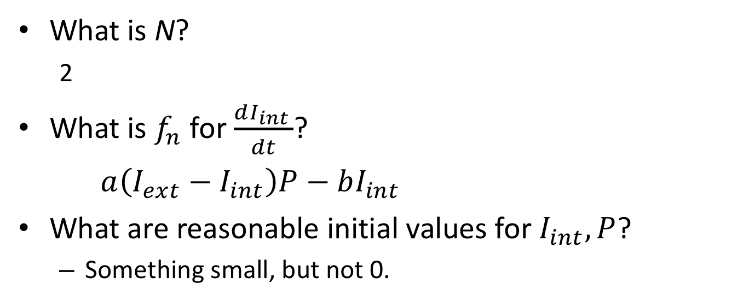

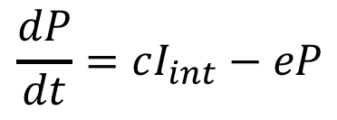
IVP for lac Operon Model
System Diagram
$I_{ext}$
$$P$$
$$I_{int}$$
$$\frac{dI_{int}}{dt}=a\left(I_{ext}−I_{int}\right)P−bI_{int}$$
$$\frac{dP}{dt}=cI_{int}−eP$$
*Vilar et al., 2003. Journal of Cell Biology.
What is N?
2
What is $f_{n}$ for $\frac{dI_{int }}{dt}$?
$a\left(I_{ext}−I_{int}\right)P−bI_{int}$
What are reasonable initial values for $I_{int},P$?
Something small, but not 0.
Notes:
State vs. input variables for time?

Slide 6
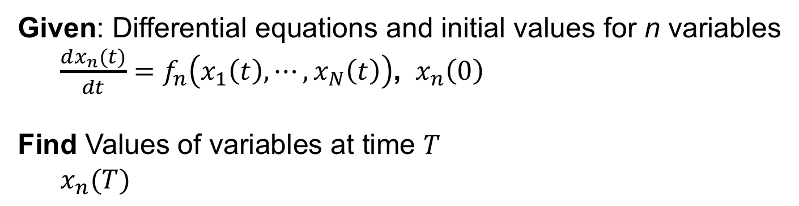
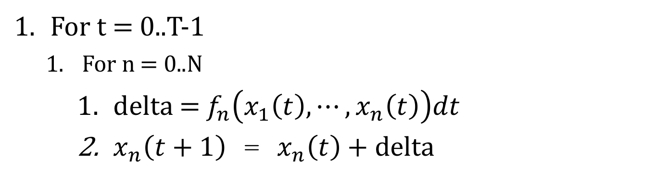
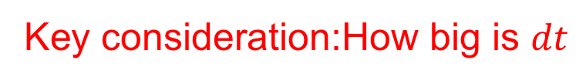
Euler Algorithm for IVP
Given: Differential equations and initial values for n variables
$\frac{dx_{n}(t)}{dt}=f_{n}\left(x_{1}\left(t\right),⋯,x_{N}\left(t\right)\right)$, ${ x}_{n}\left(0\right)$
Find Values of variables at time $T$
$x_{n}(T)$
Key consideration:How big is $dt$
For t = 0..T-1
For n = 0..N
delta = $f_{n}\left(x_{1}\left(t\right),⋯,x_{n}\left(t\right)\right)dt$
$x_{n}\left(t+1\right)$ = $x_{n}\left(t\right)$+ delta

Slide 7
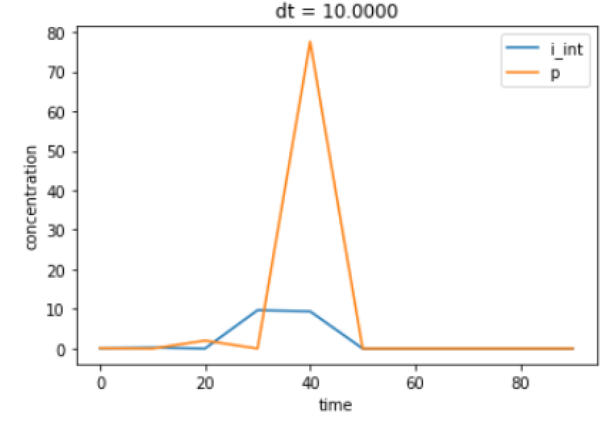
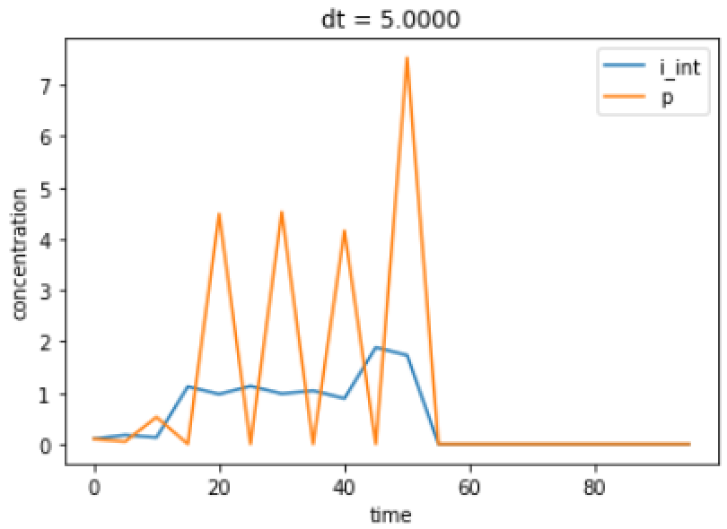
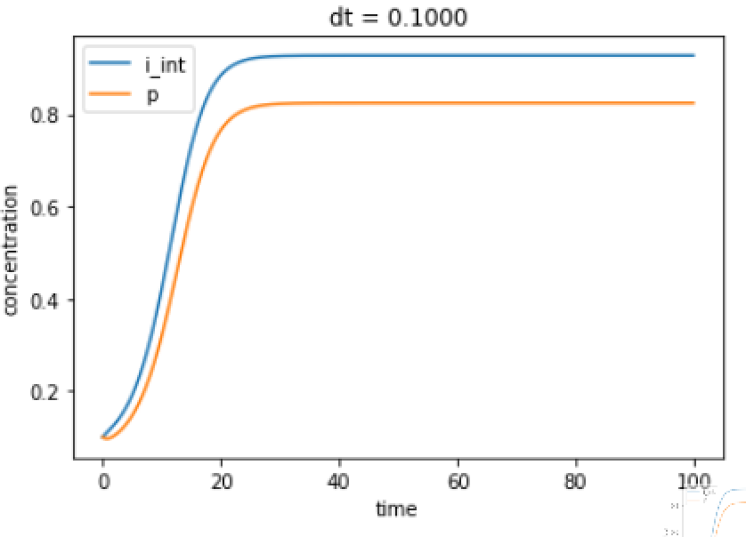
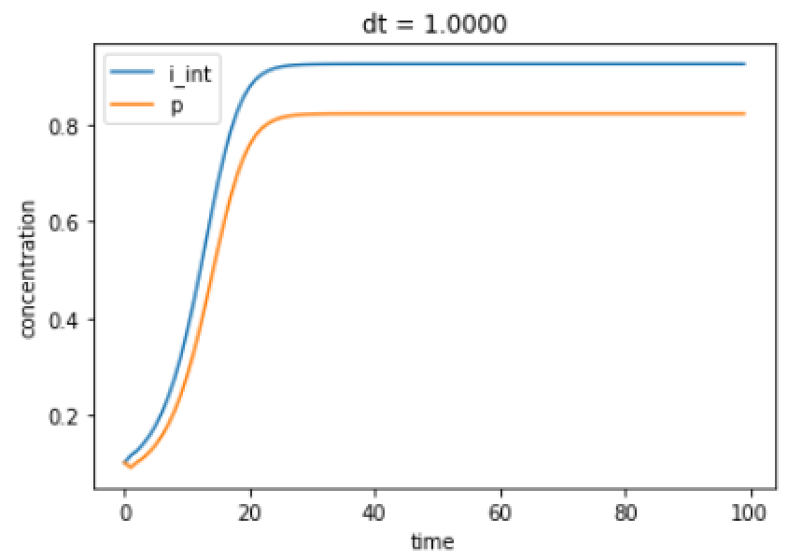
Euler for lac Operon Model
Notes:
Do we want a larger or smaller dt to improve the fidelity of the simulation?

Slide 8
Requirement for a Numerical Solution
The function is “smooth enough”
Two ways of expressing “smooth enough”
Lipschitz continuity
Smooth and uniformly monotone decreasing
If smooth enough, then
a solution will exist and be unique
we will be able to approximate it accurately with a wide variety of methods
Euler’s method is only first-order accurate (O(dt)).

Slide 9
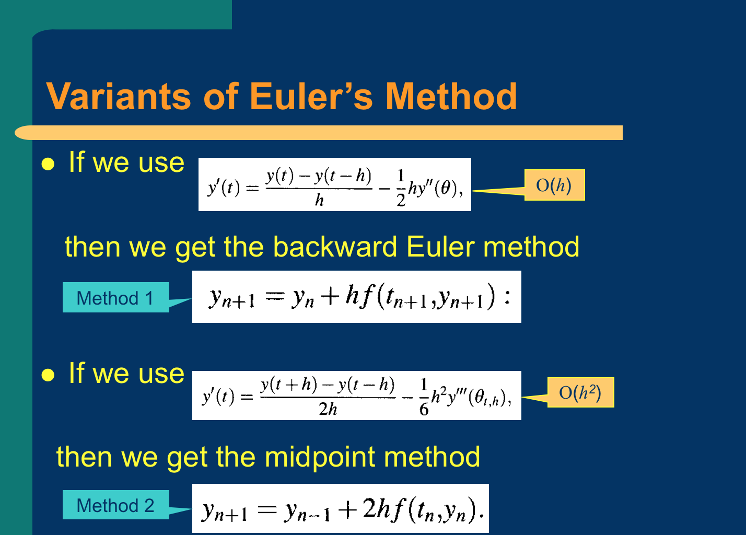

$$h=dt$$

Slide 10
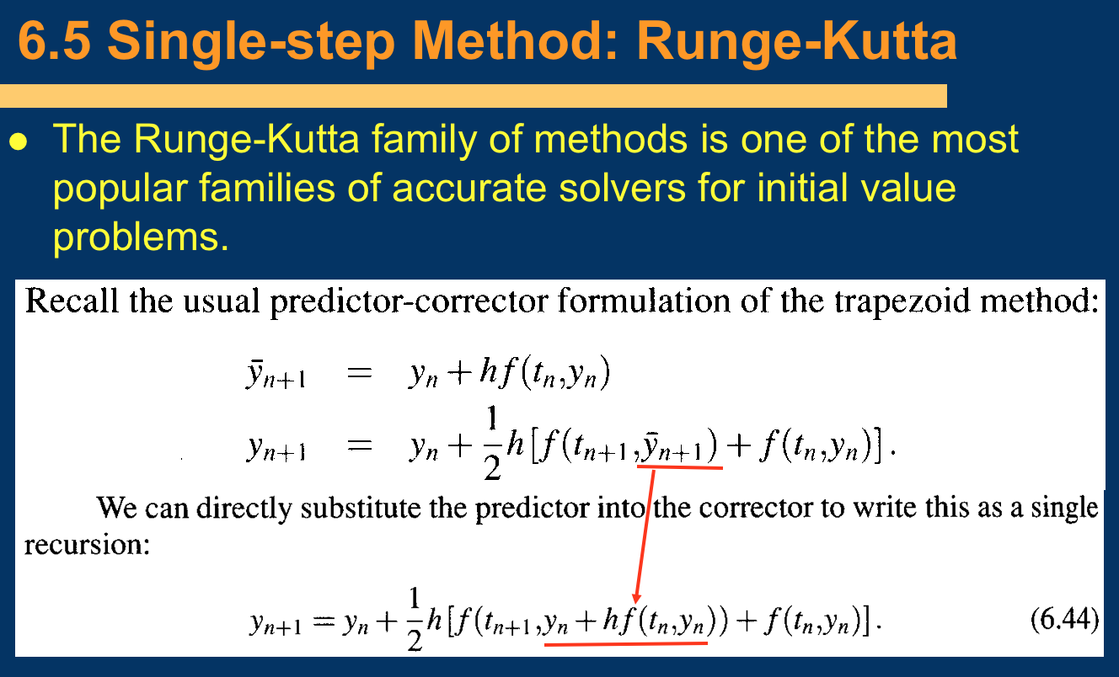

Slide 11
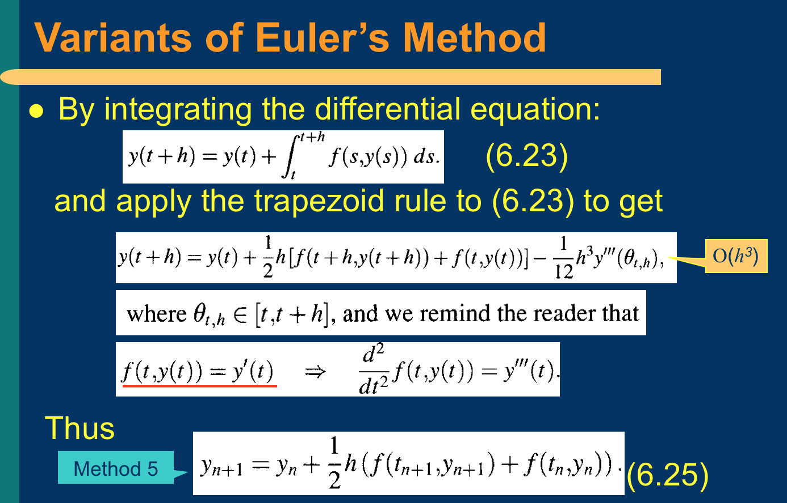

Slide 12
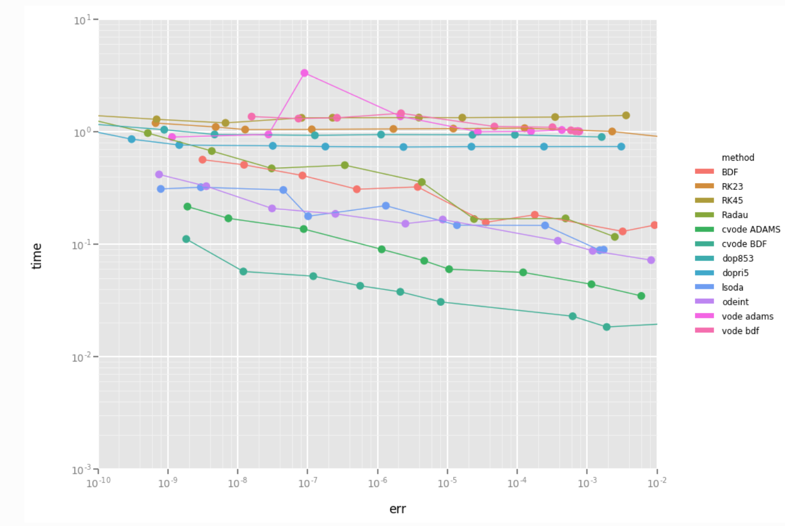
Performance of Numerical Methods

Slide 13
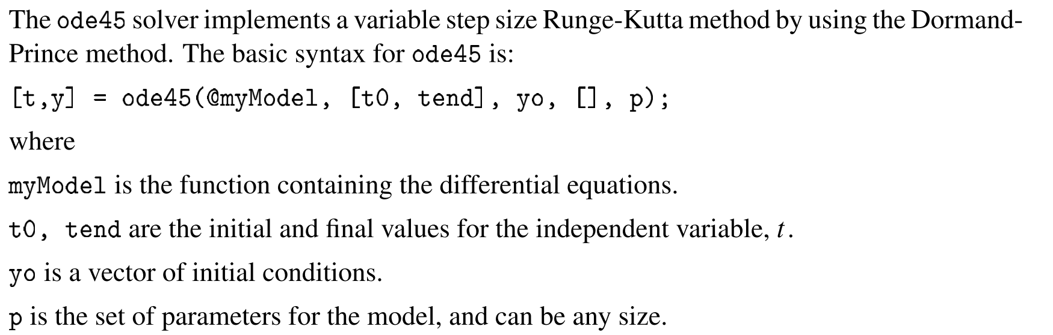
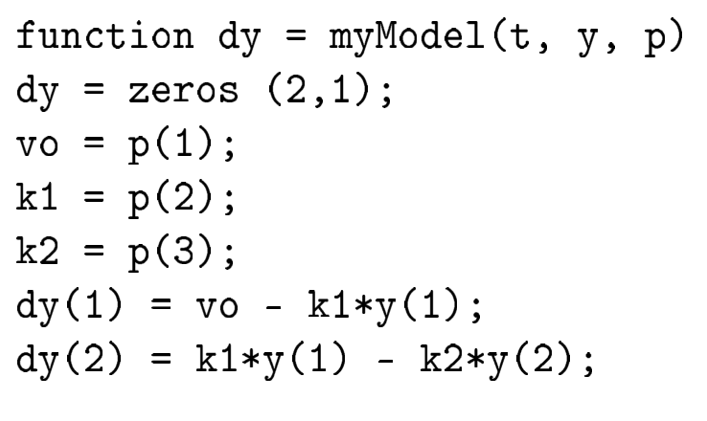
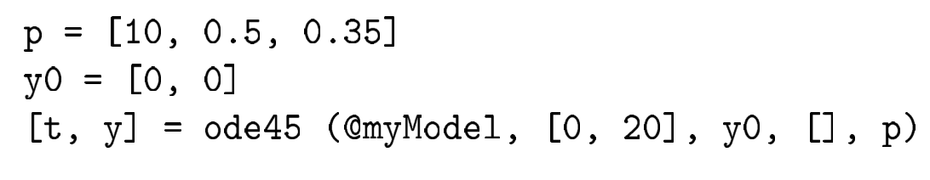
MATLAB Solver

Slide 14
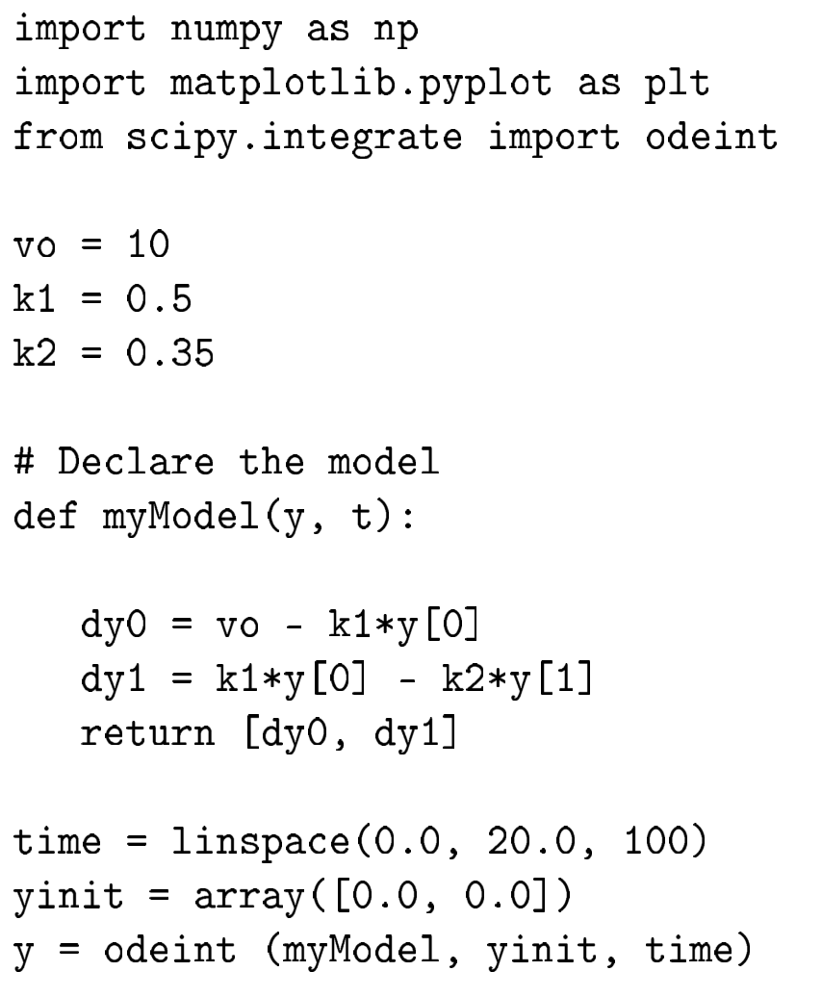
Python Solver

Slide 15
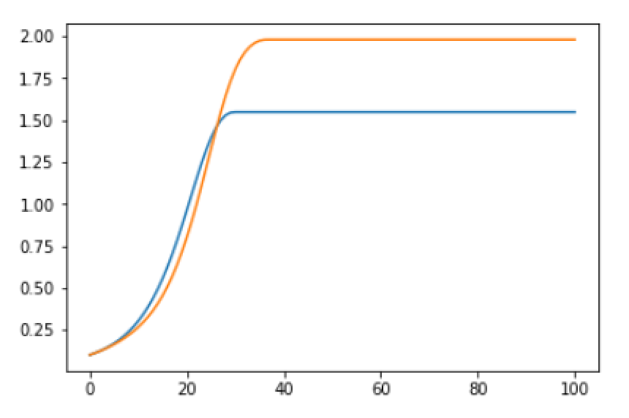
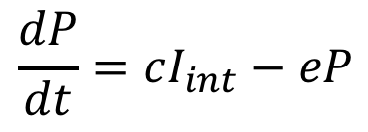
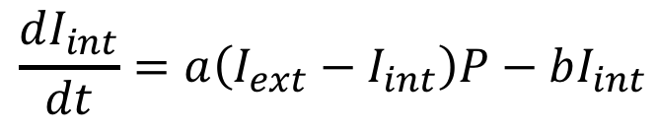
In Class Exercise Numerically Evaluate lac Operon Model
$$\frac{dI_{int}}{dt}=a\left(I_{ext}−I_{int}\right)P−bI_{int}$$
$$\frac{dP}{dt}=cI_{int}−eP$$
a = 0.5; b = 0.03; c = 0.8; d = 0.9; I_{ext} = 1.0
I_{int}(0) = 0.1; P(0) = 0.1

Slide 16


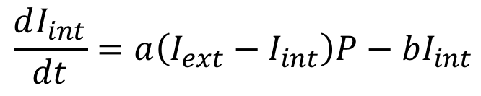

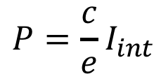
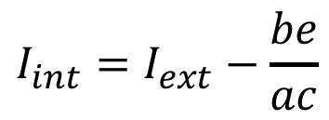

Finding Fixed Points – Steady State
Solve for variable values when derivatives are 0.
lac operon model
$$\frac{dI_{int}}{dt}=a\left(I_{ext}−I_{int}\right)P−bI_{int}$$
$$\frac{dP}{dt}=cI_{int}−eP$$
$$0=a\left(I_{ext}−I_{int}\right)P−bI_{int}$$
$$0=cI_{int}−eP$$
Solving:
$${I_{int}=I}_{ext}−\frac{be}{ac}$$
$$P=\frac{c}{e}I_{int}$$
For the values used:
$${I_{int}≈I}_{ext}$$
$$P≈2I_{ext}$$

Slide 17
System Responses
Thermodynamics in brief
Reversible system in equilibrium
Open system in steady state
Solutions in Tellurium

Slide 18
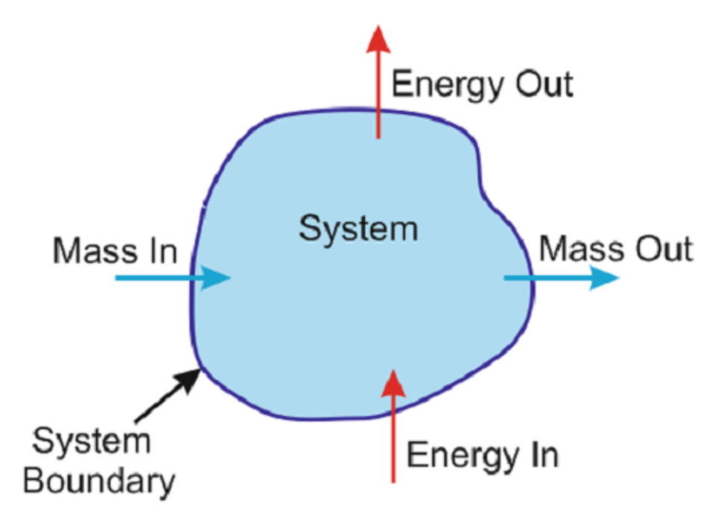
Thermodynamics: Key Definitions
What type of system is a cell?
System Types
 | No Mass Flow | Mass Flow
No Energy Flow | Isolated | X
Energy Flow | Closed | Open

Slide 19
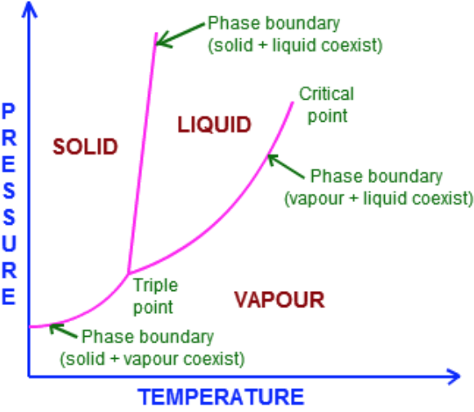
Thermodynamic Equilibrium
A system is in thermodynamic equilibrium if no infinitesimal change lowers its energy.

Slide 20
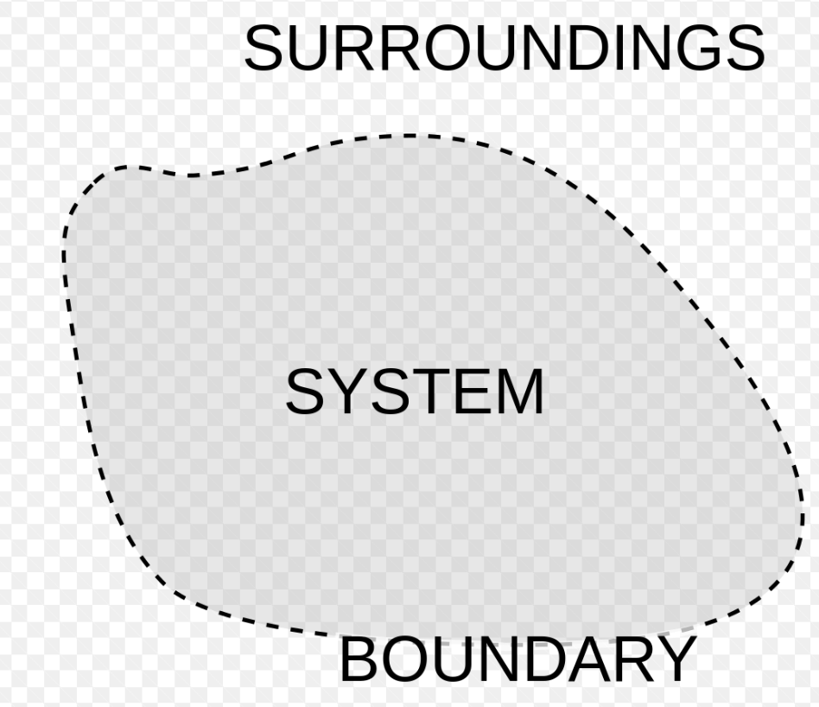
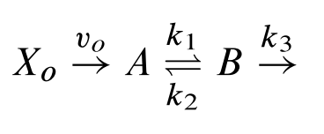


Chemical Systems
A chemical system is in equilibrium if no reaction lowers its energy and hence no net reaction take place.
An chemical system is in steady state if no concentrations are changing as time goes to infinity.
$$X_{1}$$
$$A↔B$$

Slide 21
Equilibrium and Steady State
A chemical system is in equilibrium if no reaction lowers its energy and hence no net reaction take place.
An chemical system is in steady state if no concentrations are changing as time goes to infinity.
Equilibrium implies steady state.
No reactions and so no change in concentrations
Steady state does NOT imply equilibrium
Reactions may still happen

Slide 22

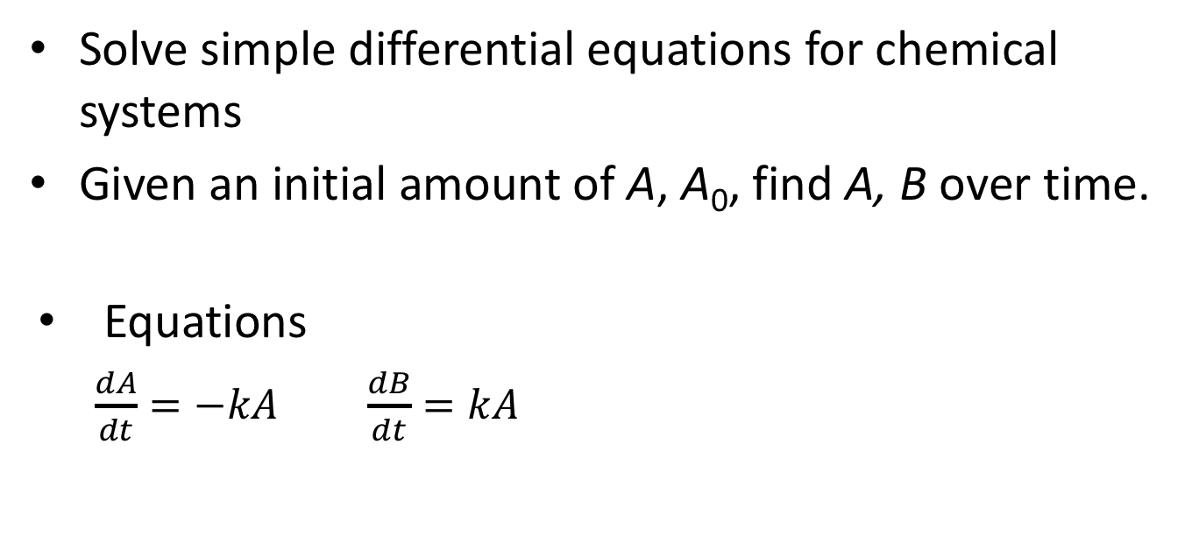
Computing Species Concentrations
Solve simple differential equations for chemical systems
Given an initial amount of A, A₀, find A, B over time.
Equations
$\frac{dA}{dt}=−kA$ $\frac{dB}{dt}=kA$
$$A→B$$

Slide 23

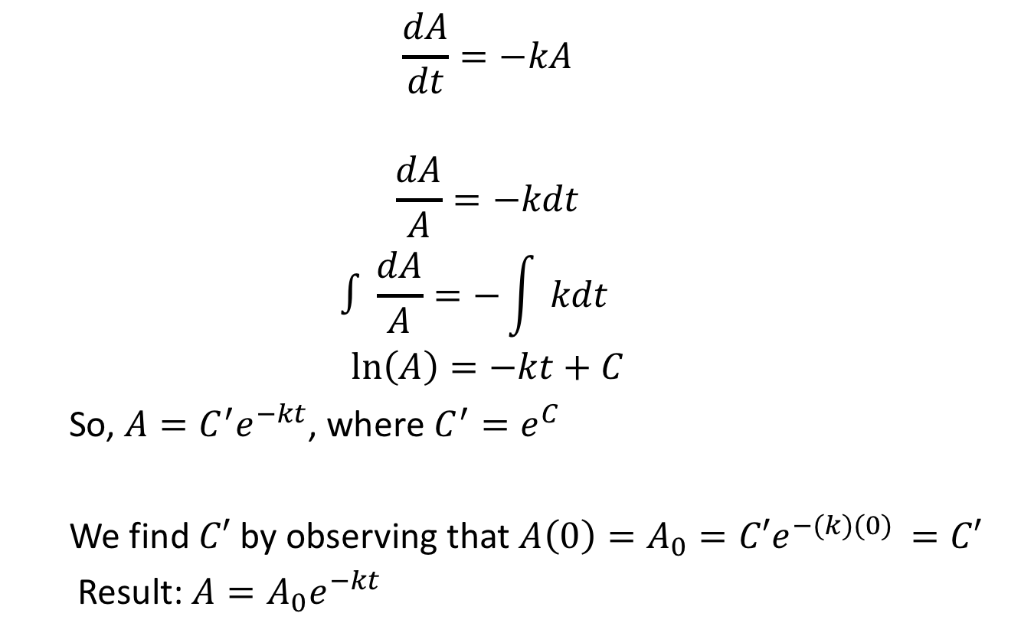
Solution by Separation of Variables
$$A→B$$
$$\frac{dA}{dt}=−kA$$
$$\frac{dA}{A}=−kdt$$
$$∫\frac{dA}{A}={−\int{kdt}}^{}$$
$$\ln\left(A\right)=−kt+C$$
So, $A=C^{′}e^{−kt}$, where $C^{′}=e^{C}$
We find $C′$ by observing that $A\left(0\right)=A_{0}=C′e^{−(k)(0) }=C′$
Result: $A=A_{0}e^{−kt}$

Slide 24
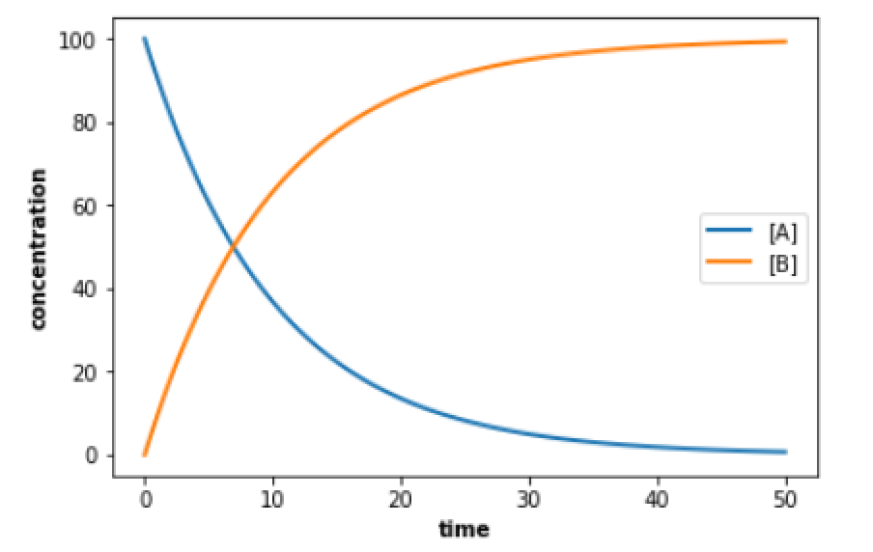
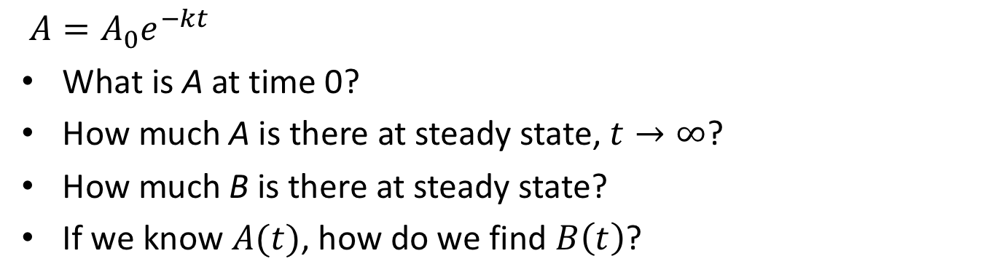

Interpreting the Solution
$$A→B$$
$A=A_{0}e^{−kt}$
What is A at time 0?
How much A is there at steady state, $t→∞$?
How much B is there at steady state?
If we know $A(t)$, how do we find $B\left(t\right)$?

Slide 25
Solving in Tellurium
te.setDefaultPlottingEngine('matplotlib’)
model = ""”
model test
species A, B;
A = 100.0;
B = 0.0;
J1: A -> B; k1*A;
k1 = 0.1;
end""”
r = te.loada(model)
r.simulate(0, 50, 100)
r.plot(xtitle="time", ytitle="concentration")
Notes:
Try doing this to verify get same result.

Slide 26
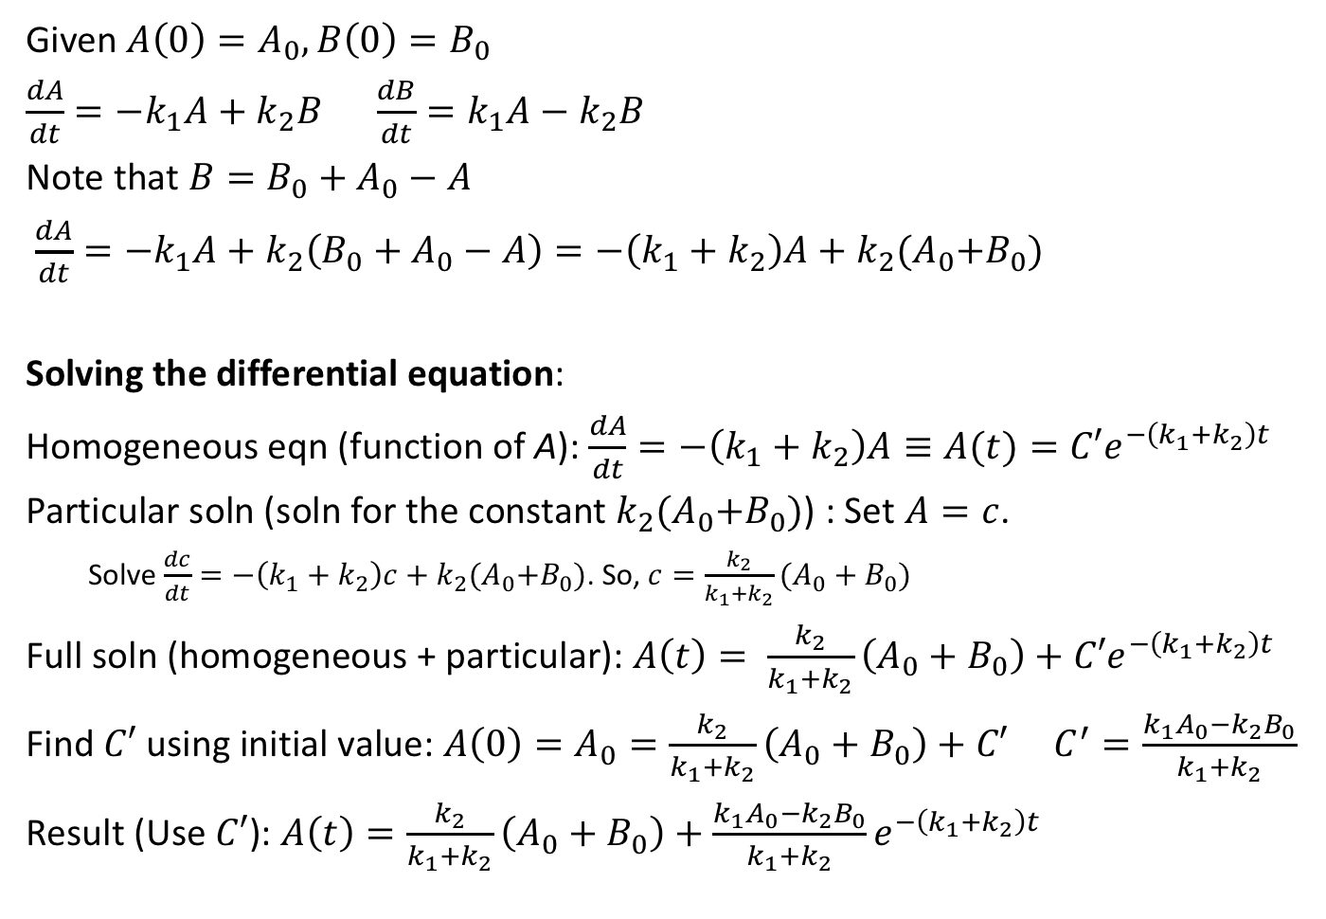

Reversible Reaction, Closed System
Given $A\left(0\right)=A_{0}, B\left(0\right)=B_{0}$
$\frac{dA}{dt}={−k}_{1}A+k_{2}B$ $\frac{dB}{dt}=k_{1}A−k_{2}B$
Note that $B=B_{0}+A_{0}−A$
$\frac{dA}{dt}=−k_{1}A+k_{2}\left({B_{0}+A}_{0}−A\right)=−\left(k_{1}+k_{2}\right)A+k_{2}{(A}_{0}+B_{0})$
Solving the differential equation:
Homogeneous eqn (function of A): $\frac{dA}{dt}=−\left(k_{1}+k_{2}\right)A≡A(t)=C′e^{−\left(k_{1}+k_{2}\right)t}$
Particular soln (soln for the constant $k_{2}{(A}_{0}+B_{0})$) : Set $A=c$.
Solve $\frac{dc}{dt}=−\left(k_{1}+k_{2}\right)c+k_{2}{(A}_{0}+B_{0})$. So, $c=\frac{k_{2}}{k_{1}+k_{2}}(A_{0}+B_{0})$
Full soln (homogeneous + particular): $A\left(t\right)= \frac{k_{2}}{k_{1}+k_{2}}\left(A_{0}+B_{0}\right)+C′e^{−\left(k_{1}+k_{2}\right)t}$
Find $C′$ using initial value: $A\left(0\right)=A_{0}=\frac{k_{2}}{k_{1}+k_{2}}\left(A_{0}+B_{0}\right)+C′$ $C^{′}=\frac{k_{1}A_{0}−k_{2}B_{0}}{k_{1}+k_{2}}$
Result (Use $C′$): $A\left(t\right)=\frac{k_{2}}{k_{1}+k_{2}}\left(A_{0}+B_{0}\right)+\frac{k_{1}A_{0}−k_{2}B_{0}}{k_{1}+k_{2}}e^{−\left(k_{1}+k_{2}\right)t}$
$$A↔B$$
Notes:
Problem: Trying to solve a differential equation with two variables. But, they are related.
Gives us an equation just in A.
Homogeneous equation is the part that

Slide 27
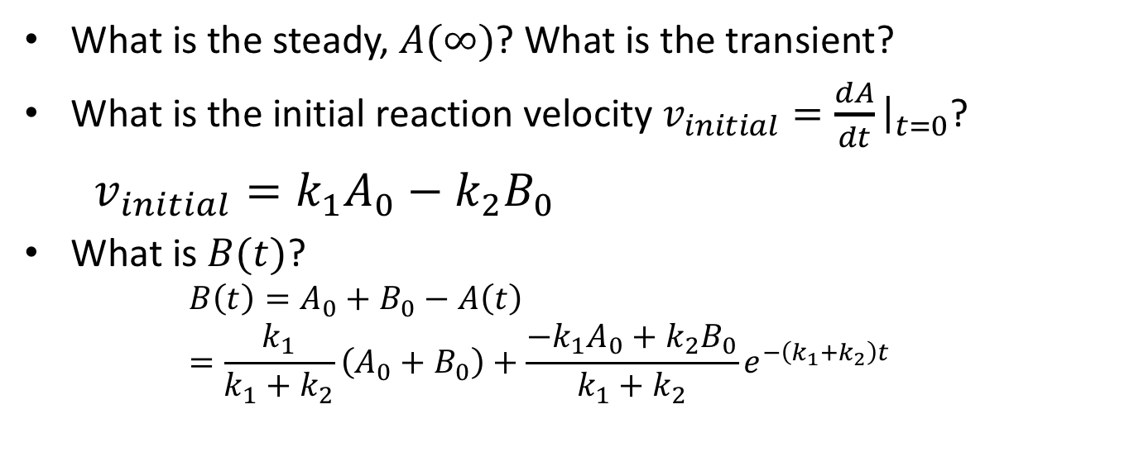


A Closer Look at the Solution to $A↔B$
$$A\left(t\right)=\frac{k_{2}}{k_{1}+k_{2}}\left(A_{0}+B_{0}\right)+\frac{k_{1}A_{0}−k_{2}B_{0}}{k_{1}+k_{2}}e^{−\left(k_{1}+k_{2}\right)t}$$
What is the steady, $A(∞)$? What is the transient?
What is the initial reaction velocity $v_{initial}=\frac{dA}{dt}{\left.​\right|}_{t=0}$?
$v_{initial}=k_{1}A_{0}−k_{2}B_{0}$
What is $B(t)$?
$$B\left(t\right)=A_{0}+B_{0}−A\left(t\right)=\frac{k_{1}}{k_{1}+k_{2}}\left(A_{0}+B_{0}\right)+\frac{{−k}_{1}A_{0}+k_{2}B_{0}}{k_{1}+k_{2}}e^{−\left(k_{1}+k_{2}\right)t}$$

Slide 28
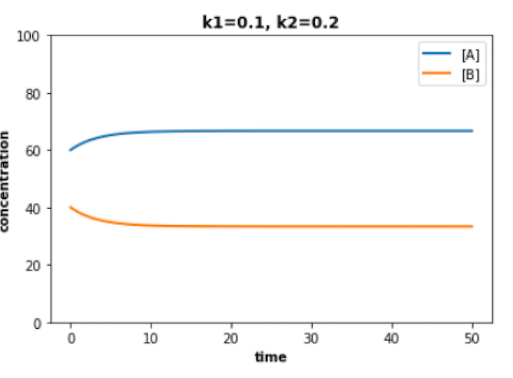
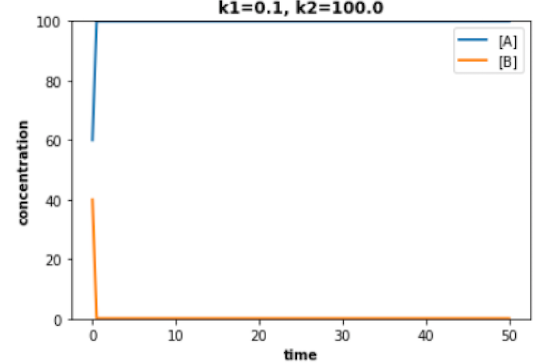
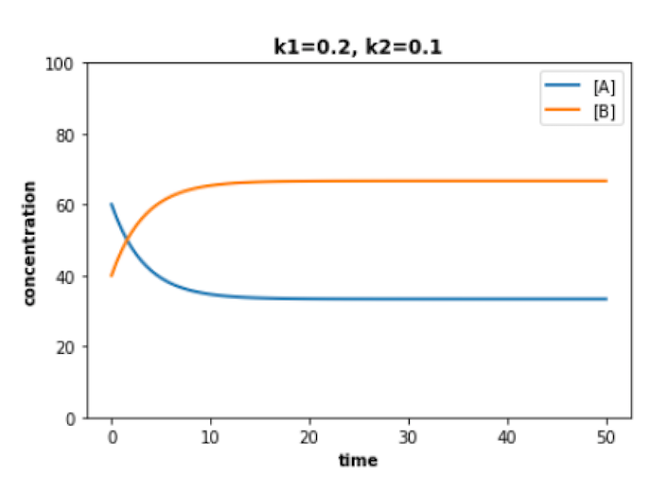
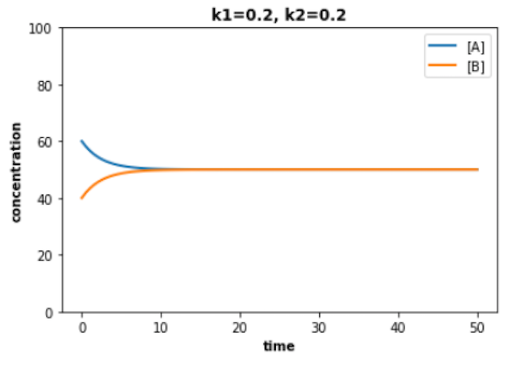
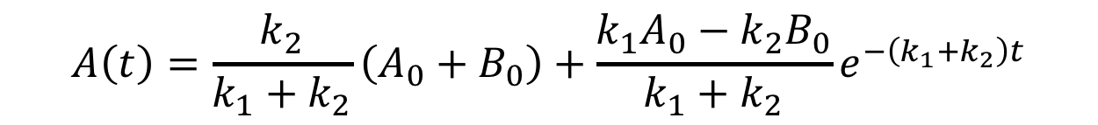

$$A↔B$$
$$A\left(t\right)=\frac{k_{2}}{k_{1}+k_{2}}\left(A_{0}+B_{0}\right)+\frac{k_{1}A_{0}−k_{2}B_{0}}{k_{1}+k_{2}}e^{−\left(k_{1}+k_{2}\right)t}$$
Questions:
What are A₀, B₀?
Where is k₁ > k₂?
What is A_{EQ}?
A
B
C
D
Notes:
Work with your neighbor to answer these questions.

Slide 29
Solution In Tellurium
model test
species A, B;
A = 60.0;
B = 40.0;
J1: A -> B; k1*A;
J2: B -> A; k2*B;
k1 = 0.1;
k2 = 0.2
end
Try it!

Slide 30
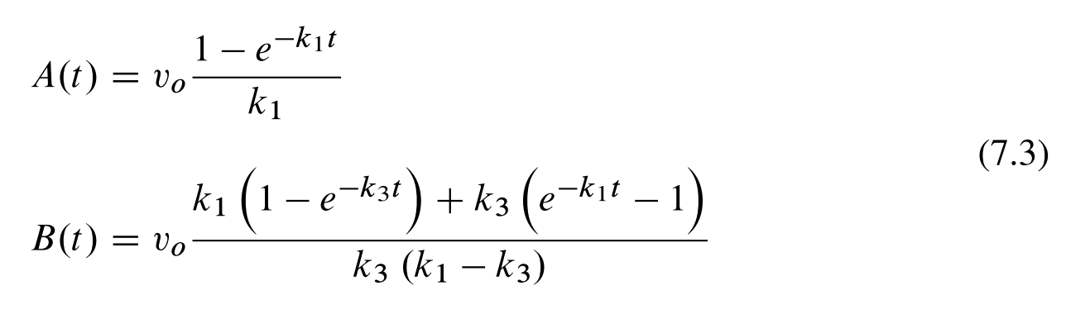


Reversible Reaction, Open System
$$X_{1}$$
(from text book)
What is $A\left(∞\right), B\left(∞\right)?$
What is $\frac{dA}{dt}{\left.​\right|}_{t→∞}?$

Slide 31
Class Exercise
$$X_{1}$$
Write a Tellurium simulation for the above system
A0 = 40; B0 = 60;
k1 = 0.1; k2 = 0.2; k3 = 0.1 vin = 1
Questions
What are the steady state values of A, B?
At what time is A = B?
How do the above change if k1=0.2, k2=0.1?

Slide 32
What You Should Know
Numerical solutions to differential equations
Euler algorithm, how improve efficiency
How use python solver
System response
Thermodynamics system types: isolated, closed, open
Transient and steady state responses
Steady state vs. equilibrium
Solutions in Tellurium

